Slide 1
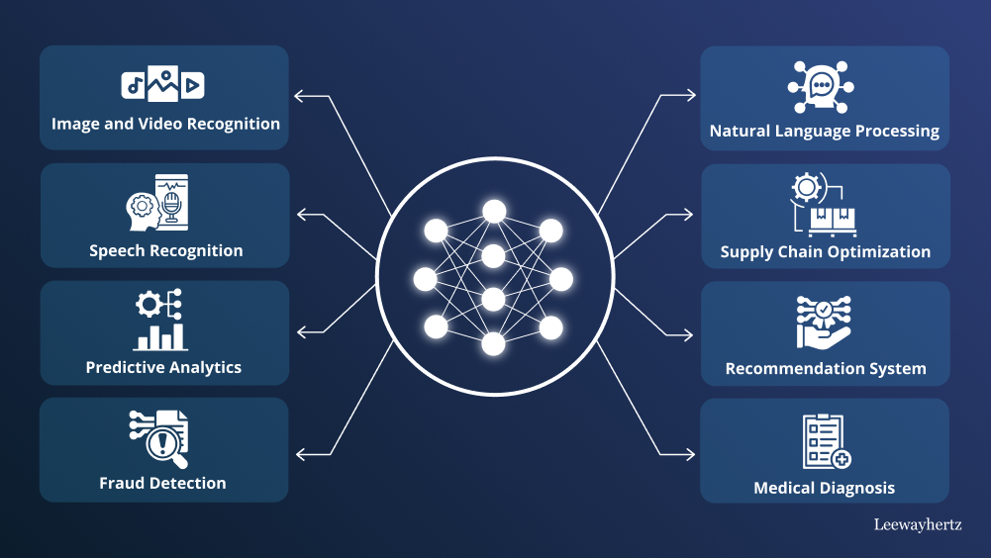
Deep Learning in Artificial Intelligence: Final Portfolio
Maira Tanweer Chachar

Slide 2
Module 1 - Module 5
Learning Points:
Introduction to Deep Learning
Deep Learning Environments, Libraries, and Tools
Neural Network Basics
Daniel Bourke Video on Code-First TensorFlow
Convolutional Neural Networks
Image Classification with Deep CNNs
Wordtransformers for Image Recognition at Scale
Introduction to Computer Vision
Sequence Modeling
NLP with RNNs
Word Embeddings vs TFIDF
Word2Vec
BERT
Assignments:
A02 A Comparative Analysis of Machine Learning and Deep Learning Tools and Frameworks
A03 Neural Network Zoo
A04 ITAI 2376 Deep Learning for an 11 year old

Slide 3
Module 6 – Module 10
Learning Points:
Transformer Architecture and Applications
Transformer Models
ViT Vision Transformer
Transformer Self-Adaptive LLMs
Linear-Time Sequence Modeling with Selective Spaces
Hallucination Mitigation Techniques in LLMs
Variational Auto Encoders VAEs
Transposed Convolutions
AutoEncoder AE vs Variational AutoEncoder VAE
GANs
U-Net Convolutional Networks
Generative AI with Diffusion Models
Diffusion Models in Various Fields
Deep Fakes
Reinforcement Learning and AI Agents
Assignments:
Mid Term: Creating Images with Diffusion Models

Slide 4
Module 11 – Module 14
Assignments:
Final Submission: Portfolio
Final Project: AI Agent Creation
Learning Points:
Reasoning Models, Agents and LLMs
LlamaIndex
AI RAG IBM
Prompt Engineering Techniques
Switch Integrate Reasoning
Generalisation Gaps
Self Correction in LLMs
Vector Database
Agent Planning and Orchestration
Multi Agent Systems and Applications

Slide 5
Thank You
Repository:https://github.com/PentaXIV/6253-ITAI-2376-Deep-Learning-Artificial-Intel-S10-14724

